Slide 1
Bangalore Rentals Analysis
Capstone project: Battle of Neighborhoods – Lovey Pathak

Slide 2
Background & Context
Bangalore, also known as Silicon City of India is a hub of 1.5M employees belonging to various IT and ITeS sector.
IT and ITeS sector has opened hugh demand for property rentals.
This project would concentrate on the need to understand the rental market better and understand if average rental prices differ in various neighborhood and if yes then by how much.
This analysis report would help owners understand the variables which impact the rental prices and for tenants this analysis would help them identify neighborhood according to their budgets and needs.
Through this report, I would like to answer following questions:
Which are the top neighborhoods in Bangalore where supply of rental properties are large ?
What are the ranges of rents in these neighborhoods?
What are the top 10 venues in these locations?
Is there any relationship between sq-ft area, furnishings, no of bedrooms, bathroom, house facing on the rental prices?
Which neighborhoods are similar?

Slide 3
Data requirements – Cleaning
Property Rental data for Bangalore City, India
Makaan.com - Use beautiful soup to scrap property listing data. Following variables would be needed for the problem at hand. Variables include
Property rentals /Area Sqft /Number of bedrooms /Bathrooms /House Facing / Furnishing /Address co-ordinates.
Geolocation data for different neighborhoods identified in the property rental data
Major venues data in neighborhoods identified above.
Data Cleaning
Two datasets were prepared using property rental and Venues data.
Issues include missing values, wrong entries, exceptionally high rental prices, address corrections.
Several neighborhoods were grouped together when the addresses belonged to same locality.
Post data cleaning, 669 neighborhoods were identified using Rentals data.
Venues data pull was clean and minimal data cleaning and alignment was required.

Slide 4
Methodology
Data Capture
Rental data
cleaning and exploration
Venues data
Analysis and segmentation
Correlation & basic linear analysis using Rental data
Group neighbors based on similarity of venues
Insights
evaluation of results and recommendations

Slide 5
Exploratory Analysis and Model used
Following key analysis and tests were conducted for generating insights
Rental density by Neighborhoods
Rental prices distribution
Area Sq-ft level
Bedrooms
Variable correlation analysis using corr()metrics and scatter charts / Heatmaps followed by multiple linear regression model to estimate p-values.
Neighborhood Analysis using K-means clustering
Analysis of each clusters for key KPIs.
Analysis of each cluster for top venues in those neighborhoods.

Slide 6
Results & findings
Cluster 1
Avg. bedroom size: 1.8
Cluster 4
Avg. bedroom size: 2.1
Cluster 5
Cluster 2
Cluster 3
Avg. Rentals : INR 16974
Avg. Area Sqft : 940 SQFT
Avg rentals for 1BHK is between 7000 – 12000
Avg rentals for 2BHK is between 13000 – 20000
Avg rentals for 3BHK is between 18000-32000
Avg. bedroom size: 1.74
Avg. Rentals : INR 23554
Avg. Area Sqft : 1036 SQFT
Avg rentals for 1BHK is between 18,000 – 25,000
Avg rentals for 2BHK is between 18,000 – 32,000
Avg rentals for 3BHK is between 22,000 - 50,000
Avg. bedroom size: 2.4
Avg. Rentals : INR 20275
Avg. Area Sqft : 1123 SQFT
Avg rentals for 1BHK is between 5000 - 20000
Avg rentals for 2BHK is between 12,000 – 30,000
Avg rentals for 3BHK is between 20,000 – 75,000
Avg. Rentals : INR 29191
Avg. Area Sqft : 1323 SQFT
Avg rentals for 1BHK is between 7000 – 12000
Avg rentals for 2BHK is between 13000 – 20000
Avg rentals for 3BHK is between 18000-32000
Avg. bedroom size: 1.8
Avg. Rentals : INR 20423
Avg. Area Sqft : 1023 SQFT
Avg rentals for 1BHK is between 8000 – 14000
Avg rentals for 2BHK is between 15000 – 30000
Avg rentals for 3BHK is between 20,000 – 55,000

Slide 7
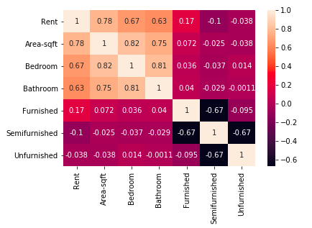
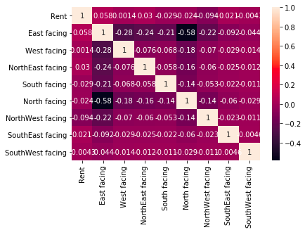
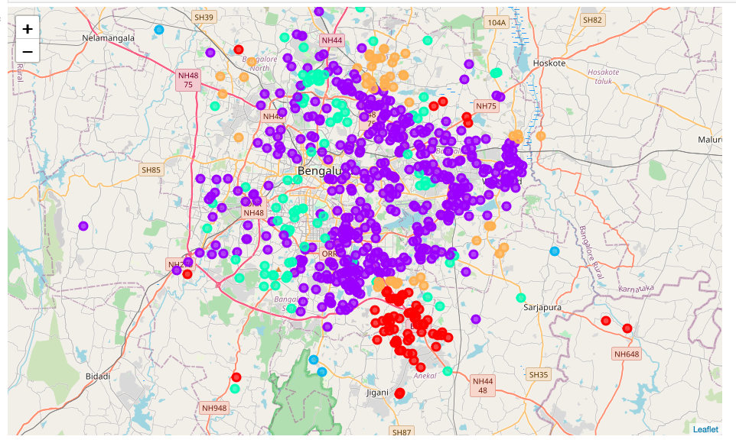
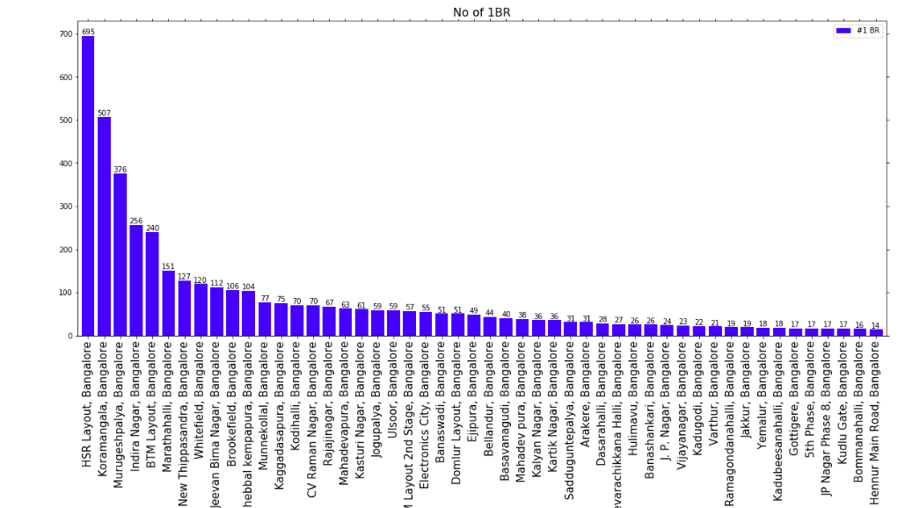
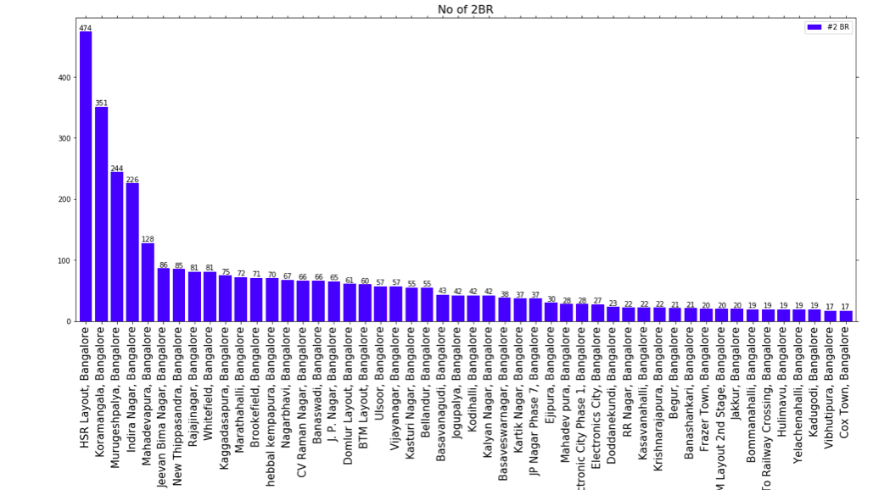
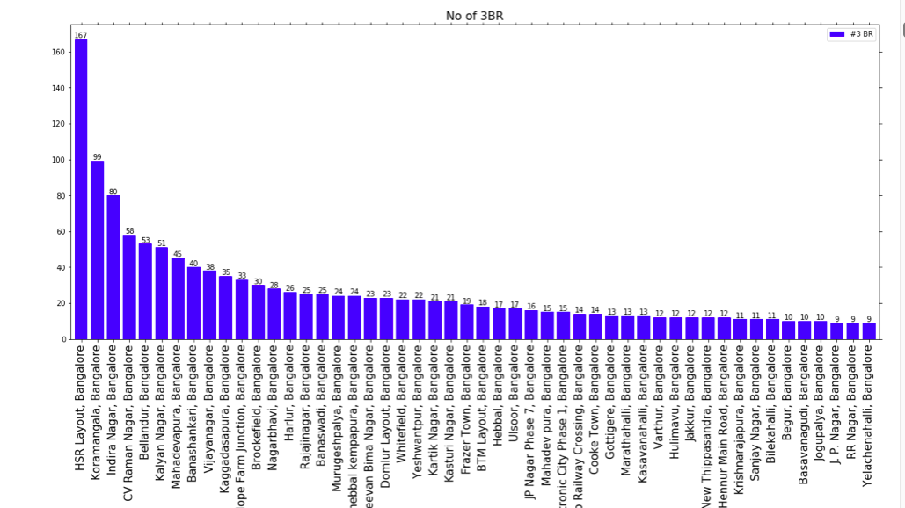
Results & findings .. Contd…

Slide 8
Discussion & Conclusion
Discussion:
The statistical analysis and exploratory study itself was sufficient to make conclusion about the rental ranges however there is a need to predict rentals in various neighborhood using significant variables.
Base model helped conclude significant variables. Also, through base model, we could explain around 60% of the deviation in rental ranges. This would mean that there are multiple other variables which are significant for example, in the current dataset variable like amenities, floor number etc were missing.
This study would definitely help owners and tenants to get a sense of different neighborhood and rental ranges.
Conclusion:
This study is done at a start level however, It would be interesting to extend this study with more variables and predict accurate rentals for different neighborhoods.

